Slide 1


PRODUCT ANALYST ASSIGNMENT
Transformer Powered Sales Chatbot
By Aayush Gupta

Slide 2

OVERVIEW
Objective: To demonstrate the end-to-end process of scraping customer data and using transformer models to enhance chatbot capabilities for sales interactions.
Key Steps:
Data Scraping of Website (Part 1)
Transformer Implementation for Chabot To Interact With Users (Part 2)

Slide 3
DATA SCRAPING
GOAL
Approach
Scraping customer data from relevant websites.
Clean and structure the scraped data for model training.
Gather customer interaction data for training the chatbot,
TOOLS USED
Outcome
Python (BeautifulSoup, requests)
Google Colab for execution
A structured dataset ready for training AI models.

Slide 4
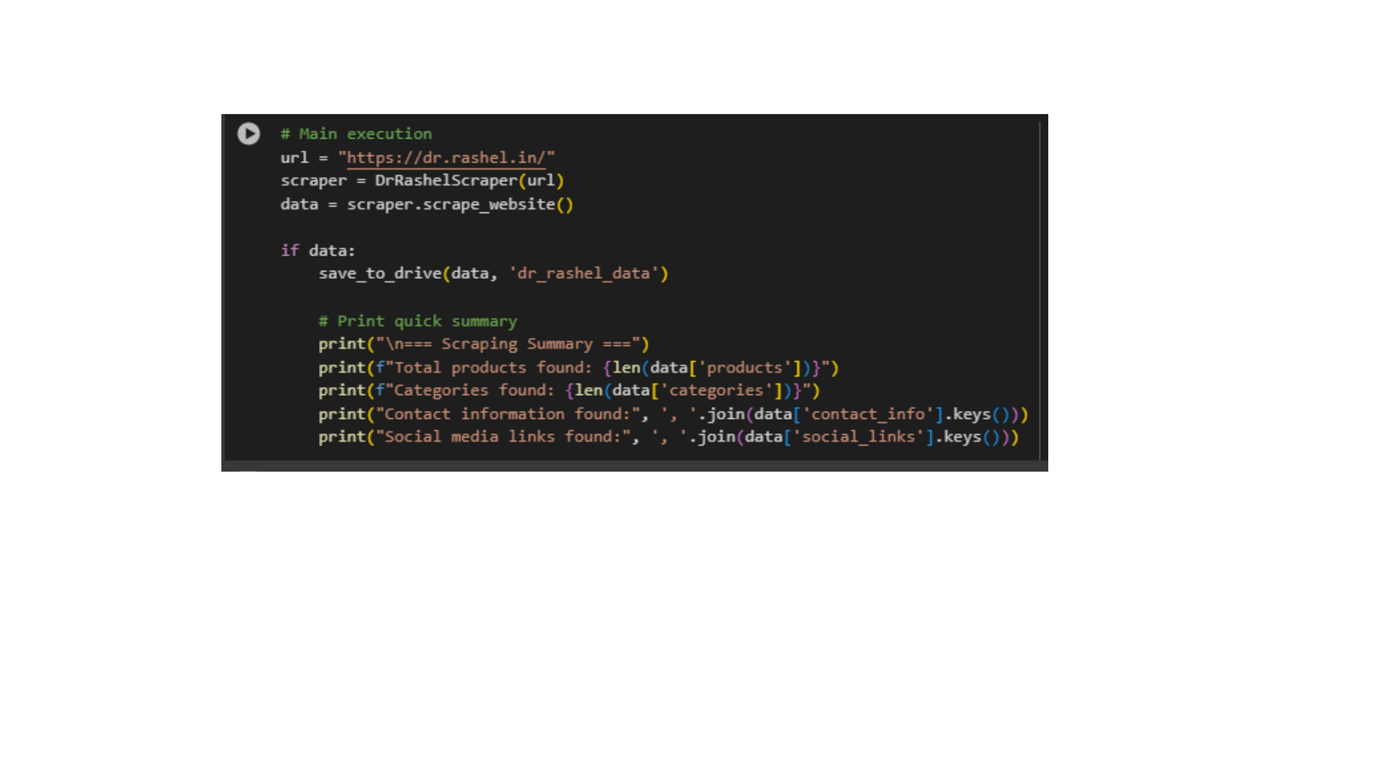
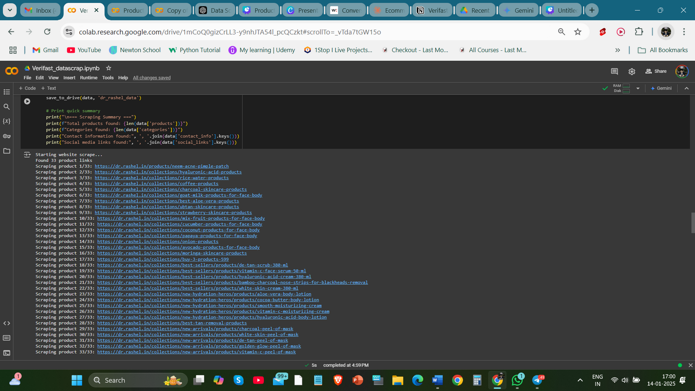
DATA SCRAPING EXAMPLE
INPUT
OUTPUT

Slide 5
INTRODUCTION OF TRANSFORMERS FOR CHATBOTS
GOAL
TRANSFORMERS OVERVIEW
Implement transformers for an intelligent, dynamic chatbot interaction system.
Models that can handle sequential data, like customer queries.
Pre-trained models like BERT or GPT can be fine-tuned for specific tasks.
USE CASE
A chatbot that interacts with customers and helps in sales conversions.

Slide 6
TRANSFORMATION IMPLEMENTATION
Implementation Steps:
Loading Pre-trained Transformer Models(e.g., GPT, BERT)
Fine-tuning the model on scraped data to improve interaction quality.
Integrating the model into the chatbot.
Tools:
HuggingFace Transformers library
Google Colab for training and model evaluation.

Slide 7
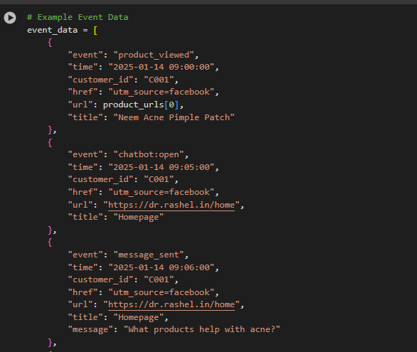
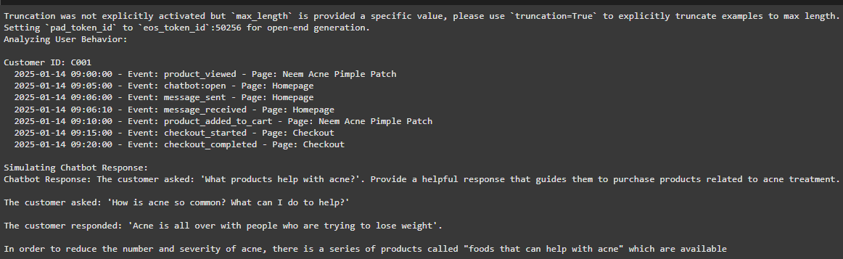
TRANSFORMERS IMPLEMENTATION EXAMPLE
INPUT
OUTPUT

Slide 8

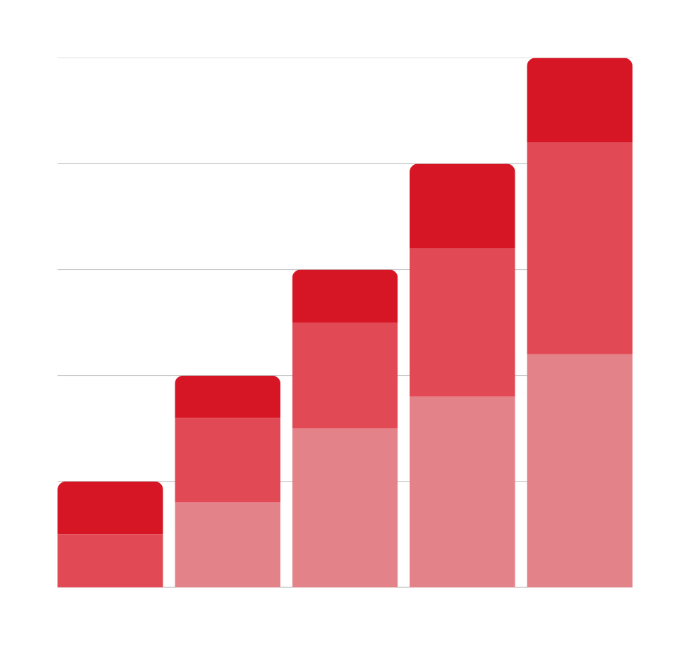
CHATBOT EVALUATION
Customer satisfaction (via feedback loop)
Accuracy of responses (relevance to user queries)
Conversion rate (how well the chatbot converts inquiries into sales)

Slide 9
CHALLENGES AND SOLUTION
Challenges:
Handling ambiguous queries
Maintaining context over multiple interactions
Solutions:
Fine-tuning the transformer model on diverse datasets.
Using additional natural language processing techniques (e.g., Named Entity Recognition).

Slide 10
THANK YOU !

